Slide 1


dashup Final Presentation
Team dashup, SAP
18. June 2019

Slide 2

Business Needs

Slide 3











ashup

Slide 4
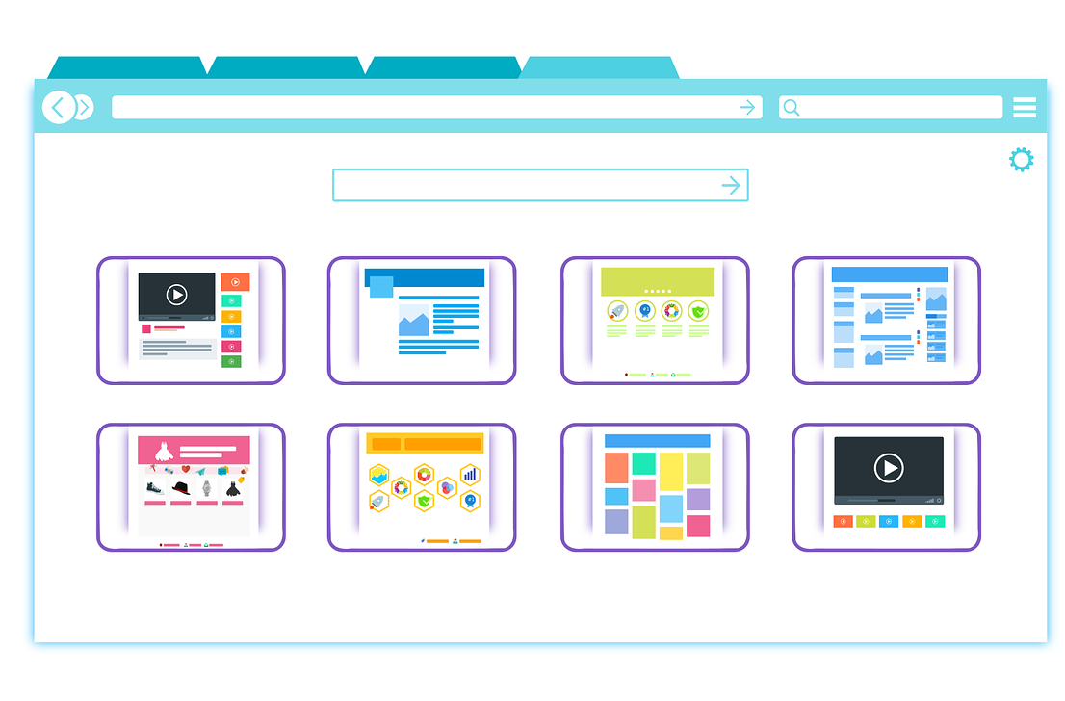


Requirements Use Cases
Widgets
Layout
User Management

Slide 5


Requirements Use Cases
Workbench
Marketplace
Software Requirements Specification
Notes:
Scope
No replacement entire functionality of application
No deployment of apis
No custom executable code upload
Use Case Diagram

Slide 6

Technical ability - Demo

Slide 7

Project Management

Slide 8
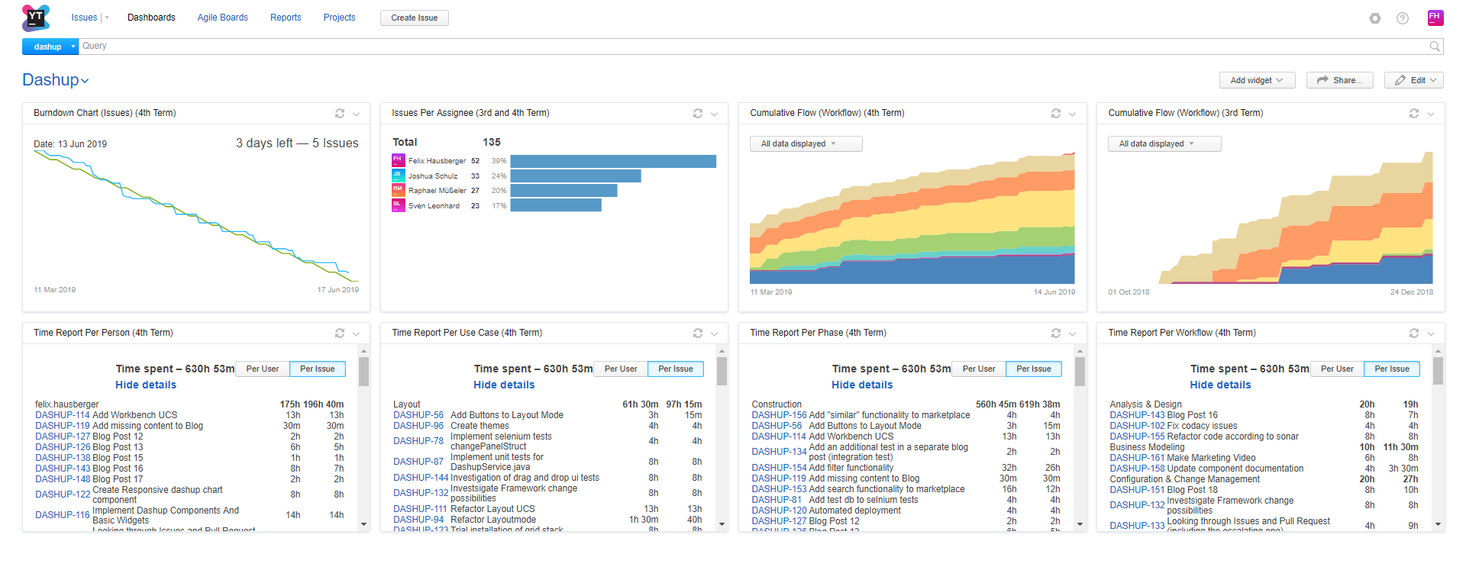
Project Methodology Scrumming with YouTrack & RUP
Agile And Transparent
Notes:
Scrum
Product Owner
Scrum Master
Team
Why? And why beneficial for the client?
Rational Unified Process -> Next slide

Slide 9
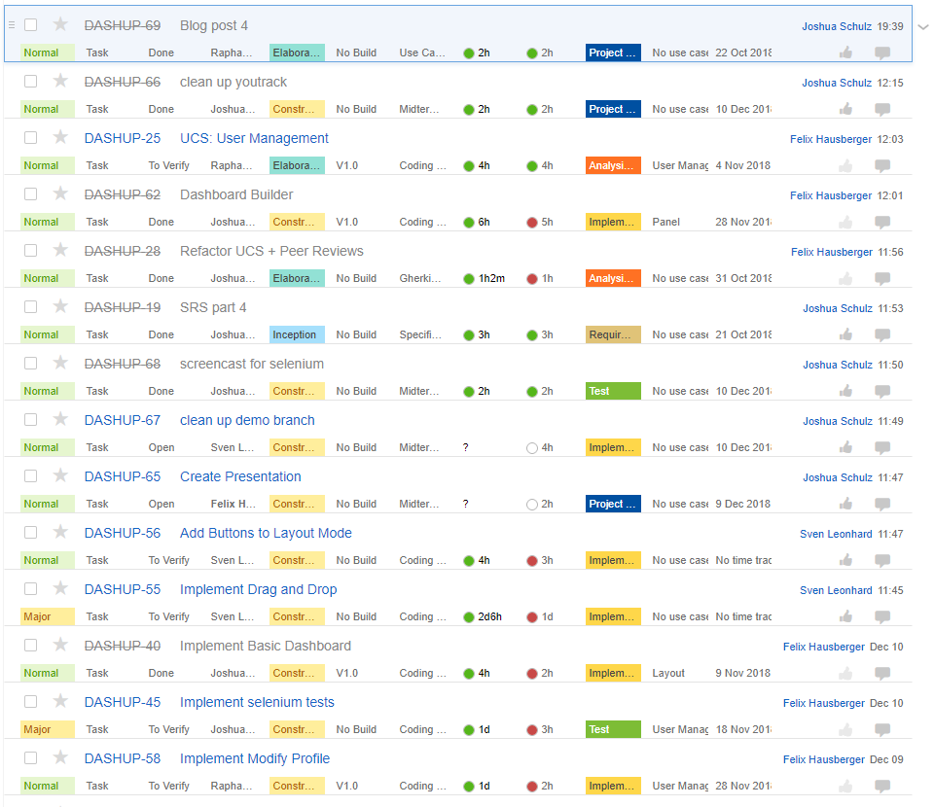
Project Management Rational Unified Process – Issues List
Notes:
Rational Unified Process
Weekly Meetings
Continuous Reviews
Iterative Process
Roles
Software Architect/Designer
Requirements specifier, Tool Specialist, Project Manager
Test Designer
Configuration/Change Control Manager, Deployment Manager, Implementer
Why?
Long Term Planning -> Next slides

Slide 10
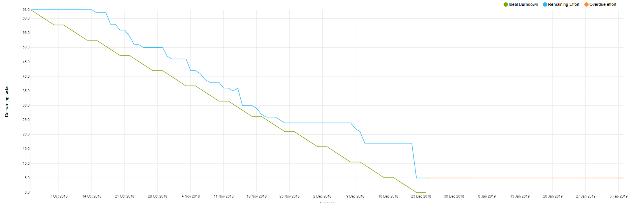
Project Management Burndown Chart 3rd semester

Slide 11
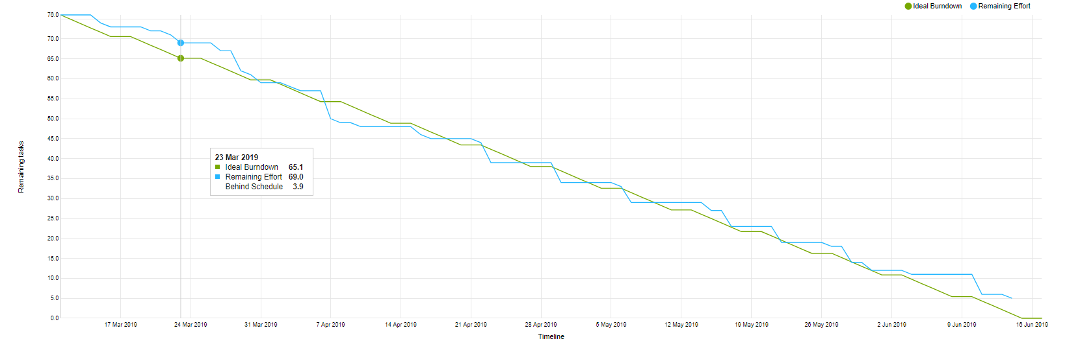
Project Management Burndown Chart 4th semester

Slide 12
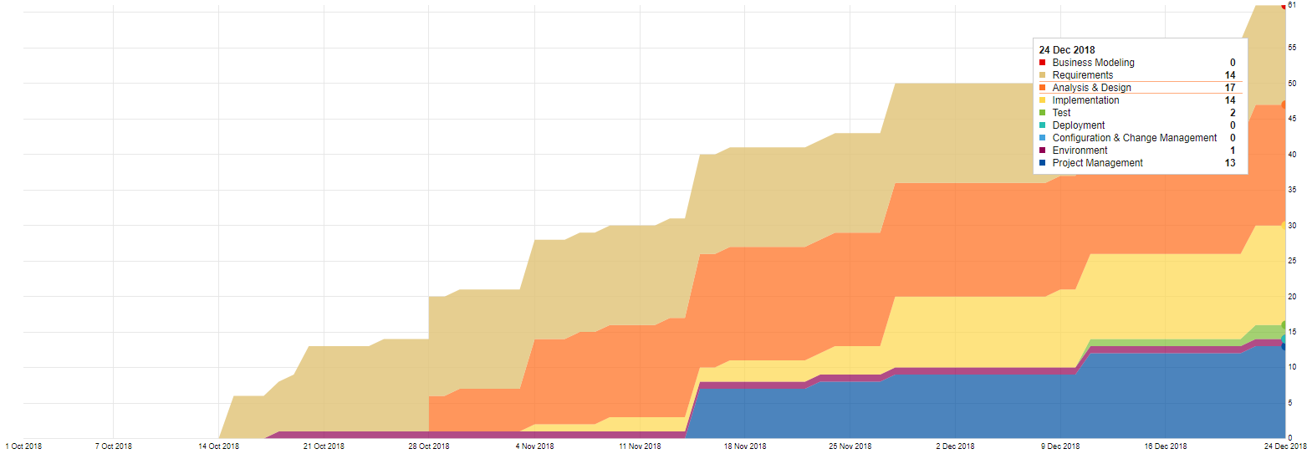
Project Management Cumulative Flow 3rd Semester

Slide 13
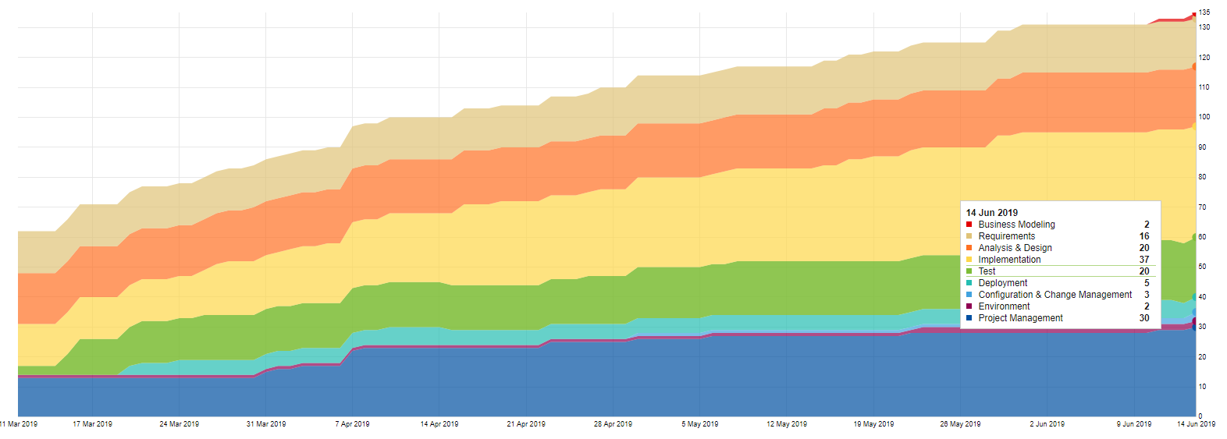
Project Management Cumulative Flow 4th Semester

Slide 14
Project Management - Cost Estimation Estimated Time and Function Points
Workbench
Marketplace
Widgets
Time Estimated: 59.7h Time Spent: 72.5h Function Points: 47.6
Time Estimated: 61.0h Time Spent: 121h Function Points: 48.6
Time Estimated: 58.6h Time Spent: 168.7h Function Points: 46.6

Slide 15
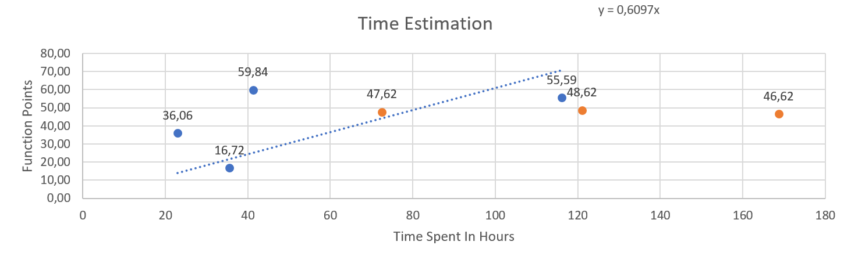
Project Management - Cost Estimation Estimated Time and Function Points
~ 850 Hours
1000+ commits

Slide 16

Project Management Risk Management
Highest Risks:
Side Tasks
Bad Time Estimation
Documentation not detailed enough
Hardware Problems

Slide 17
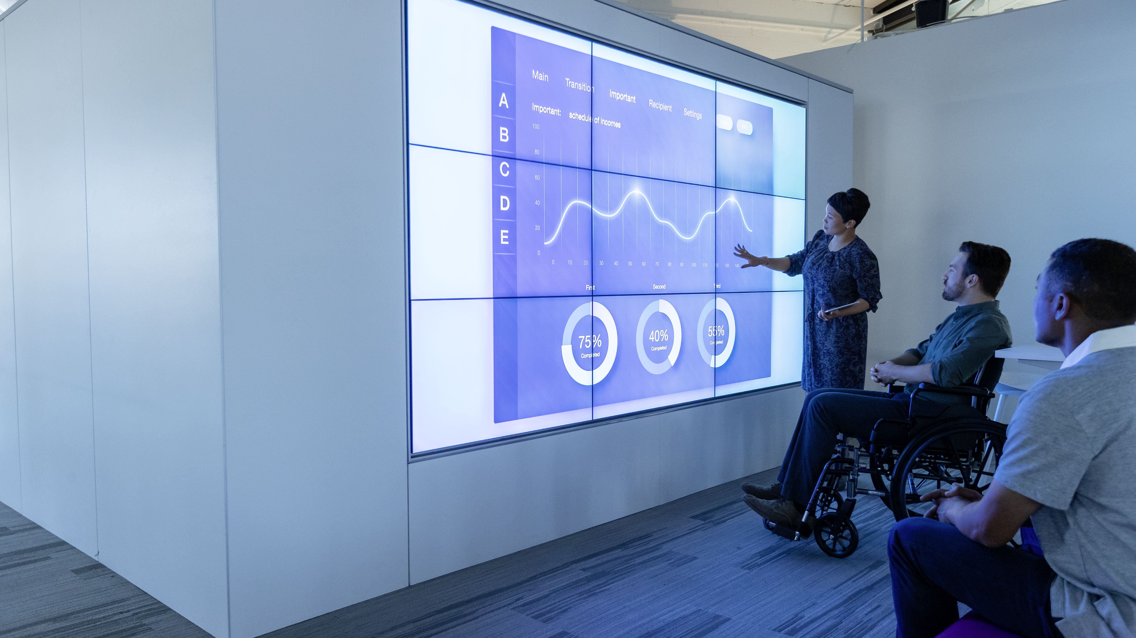
Quality

Slide 18

Architecture

Slide 19
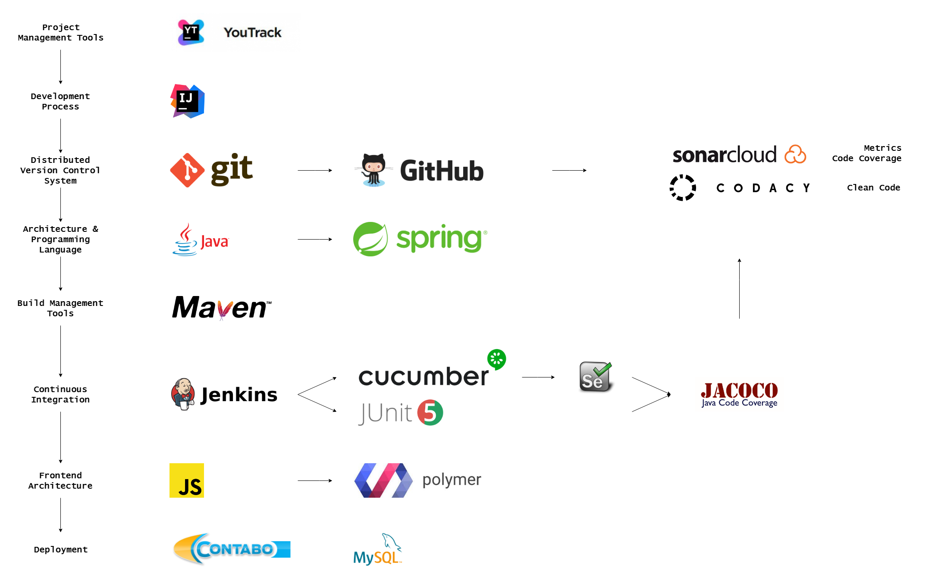
Architecture Tech-Stack

Slide 20
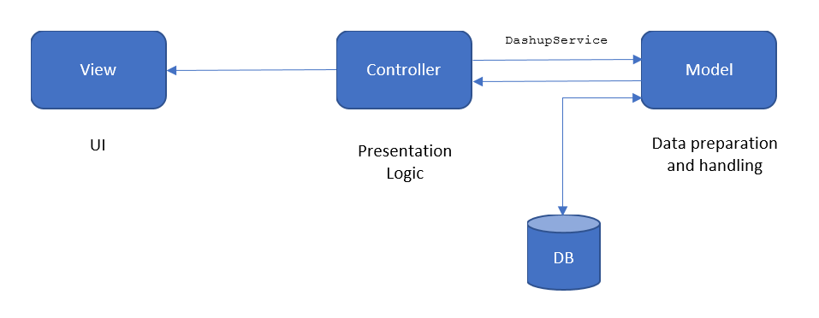
Architecture Class Diagram
Software Architecture Document
Notes:
Spring:
MVC Structure:
Model View Controller
Seperated by Modules
Maven:
Vorteil: lifecycles
Prädestiniert für Java (Menge an libraries)

Slide 21
Architecture Model-View-Control (MVC)
Notes:
Spring:
MVC Structure:
Model View Controller
Seperated by Modules
Maven:
Vorteil: lifecycles
Prädestiniert für Java (Menge an libraries)

Slide 22
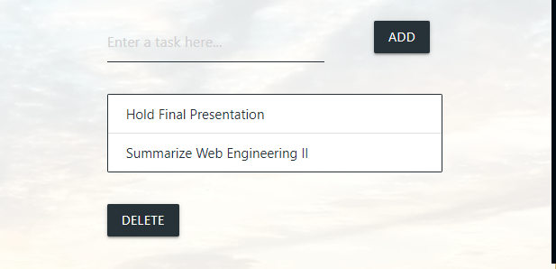
Architecture dashup components
<dashup-grid-layout>
…
<dashup-button name="Add" mode="add" dataAPI="https://dashup.de/loadTodo" storageAPI="https://dashup.de/todo“ consumers=" [{"list": "todo", “list“: “apiData list"}]“ … layout ="{"row“: 1, "offset": 1, "size“: 3}" />
…
</dashup-grid-layout>
Dashup Component Documentation

Slide 23
Architecture Patterns – Dependecy Injection & Lazy Initialization
Injector
injects
Client
Service
uses

Slide 24
Lifecycle

Slide 25
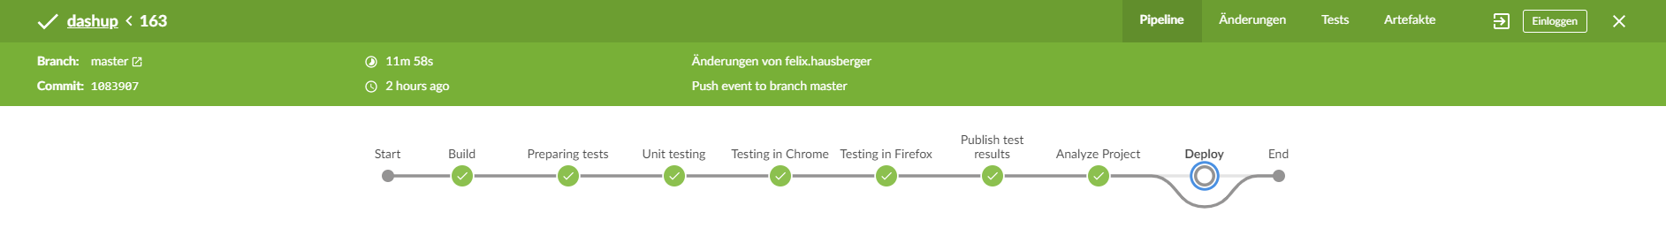




Lifecycle Continuous Integration And Automation
Notes:
Why is automated testing important?
How is it integrated? (project management and software engineering process
What does it mean for the customer?

Slide 26
Architecture Configuration
Starting Spring application via Maven Plugin
Deployed on VServer (http://dashup.de, Login: http://dashup.de/entry/login)
Using nginx with revers proxy
Configuration Management Project Plan
Notes:
- No Tomcat server

Slide 27

Testing

Slide 28



Testing Unit and Integration Testing
Test Coverage: 50%
Test Plan
Notes:
Unit Tests
UI Tests
Smoke Tests

Slide 29

Testing Code quality
Grade: A

Slide 30
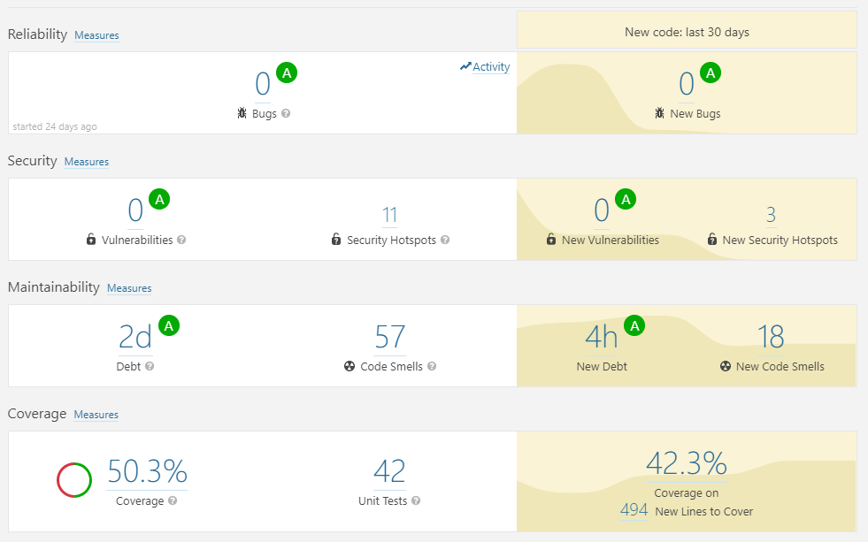


Testing Metrics
Metrics Reloaded IntelliJ Plugin
Notes:
Which did we use?

Slide 31
Thank You.
Contact Information
Felix Hausberger
Customer Service
Felix.Hausberger@sap.com
0151/51377589
Blog:
https://dashup2k18.wordpress.com/

Slide 33
Template 1
[Text]
[Text]
[Text]

Slide 34
Template 2

Slide 35
Template 3
Ebene 1
Ebene 2
Ebene 3
Ebene 4
Ebene 5

